Slide 1
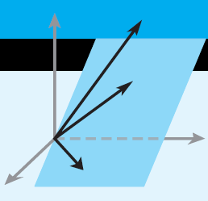
Elementary Linear Algebra
Howard Anton
Copyright © 2010 by John Wiley & Sons, Inc.
All rights reserved.
Chapter 9

Slide 2
Chapter 9
Numerical Methods
9.1 LU-Decompositions
9.2 The Power Method
9.3 Internet Search Engines
9.4 Comparison of Procedures for Solving
Linear Systems
9.5 Singular Value Decomposition
9.6 Data Compression Using Singular Value
Decomposition

Slide 3
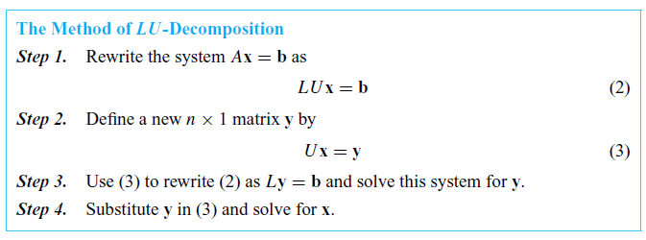
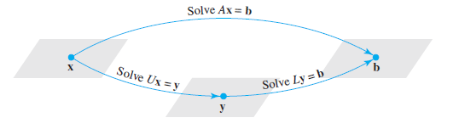
Section 9.1 LU-Decompositions

Slide 4
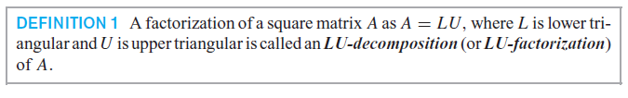
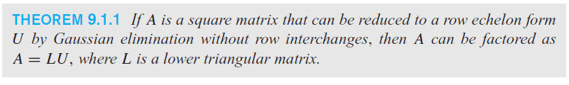
Finding LU-Decompositions

Slide 5
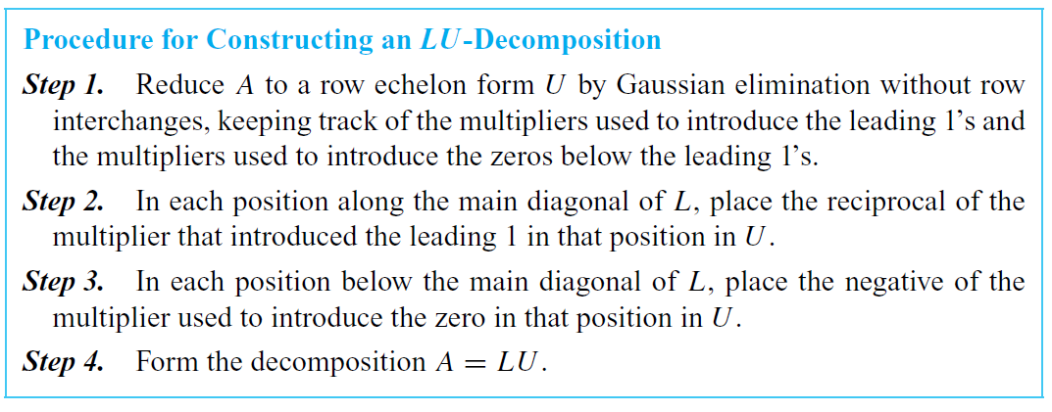
Constructing an LU-Decomposition

Slide 6
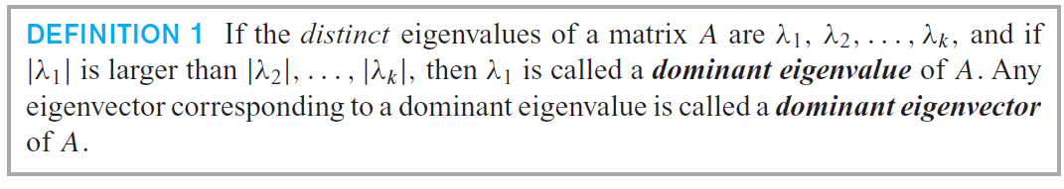
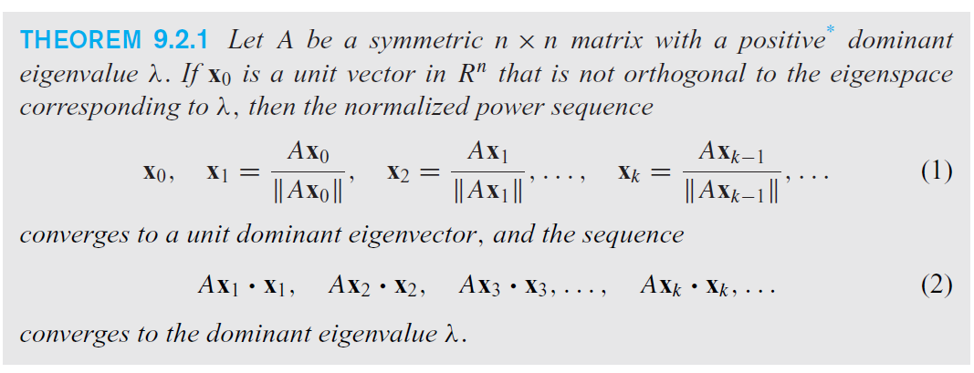
Section 9.2 The Power Method

Slide 7
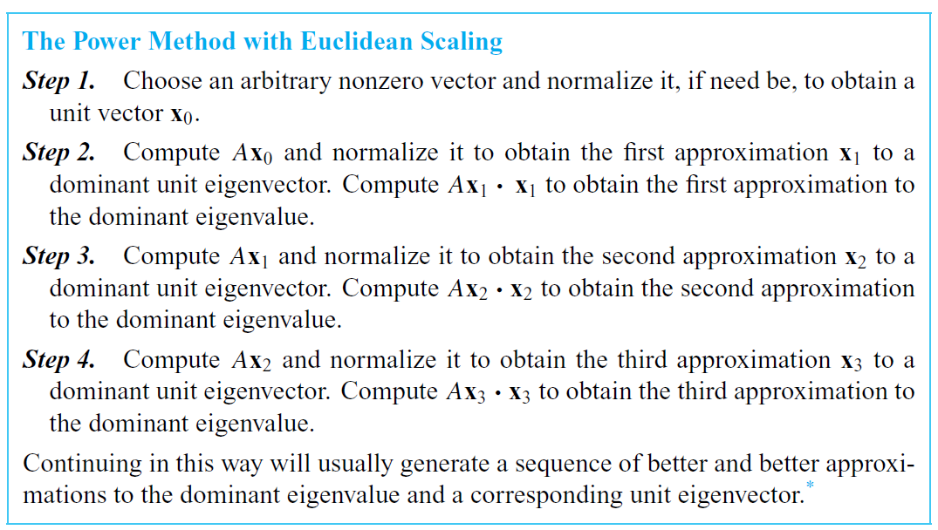
The Power Method with Euclidean Scaling

Slide 8
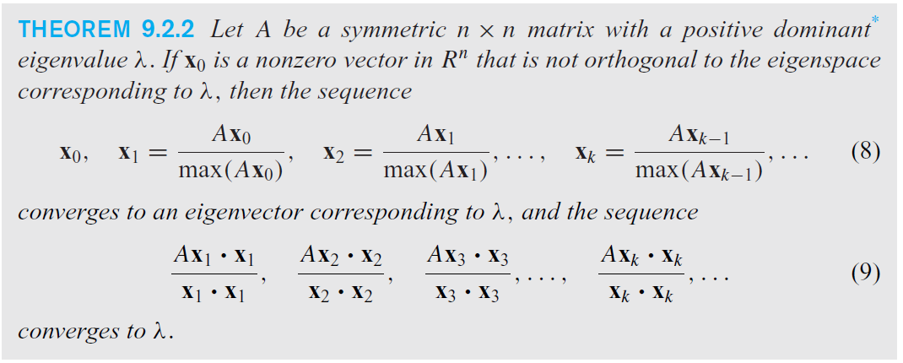
Positive Dominant Eigenvalue, λ

Slide 9
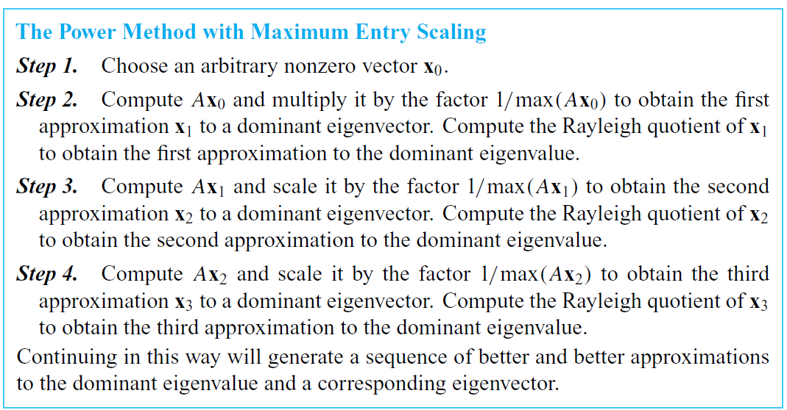
The Power Method

Slide 10
Section 9.3 Internet Search Engines
Google, developed in 1996, uses a procedure known as the PageRank algorithm to analyze how relevant sites reference one another. They build a search set, S, containing n sites, and define an adjacency matrix for S to be the nxn matrix A = [a_{ij}] in which
a_{ij} = 1 if site i references site j
a_{ij} = 0 if site i does not reference site j
With the assumption that no site references itself, the diagonal entries of A will all be 0.

Slide 11
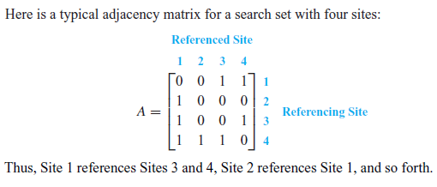
Adjacency Matrices

Slide 12
Section 9.4 Comparison of Procedures for Solving Linear Systems
A flop is an arithmetic operator on two real numbers.
The cost of a solution is the total number of flops required to solve a problem.
In Gauss- Jordan elimination and LU- decomposition, the cost of solving a linear system is approximated by 2/3 n³ + n²

Slide 13
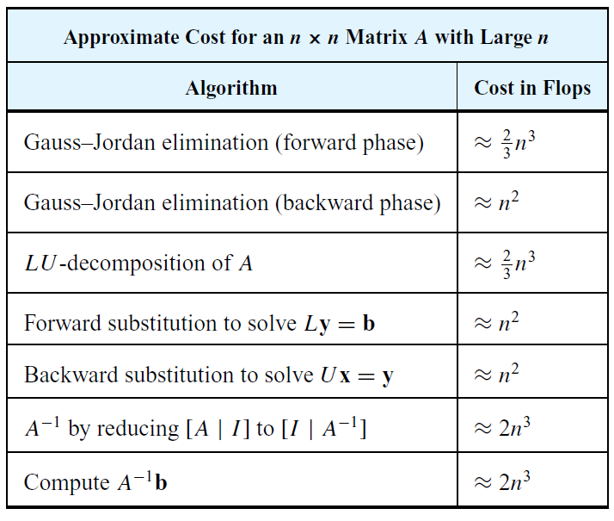
Approximate cost for an nxn Matrix A with large n

Slide 14
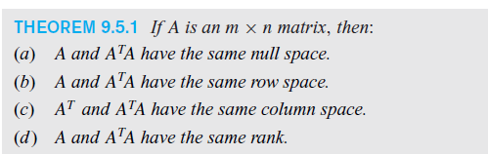
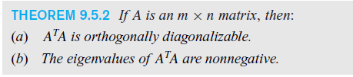
Section 9.5 Singular Value Decomposition

Slide 15
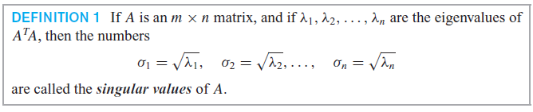
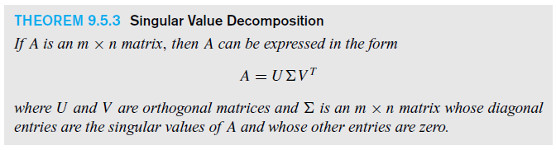
Singular Value Decomposition

Slide 16
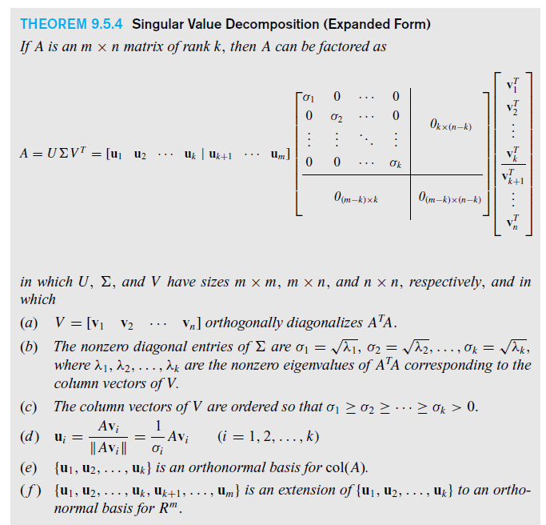

Slide 17
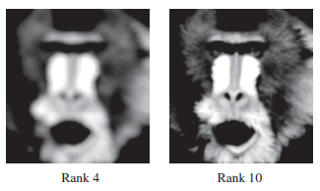
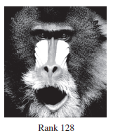
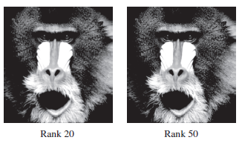
Section 9.6 Data Compression Using Singular Value Decomposition

